Slide 1

Medication Adherence Support System
Patient-Facing App Technical Presentation
CS 6440: Introduction to Health Informatics - Fall 2016 - Georgia Tech
FHIR STOP is...
Arnab Barua
Adam Hachey
Mark Mullison (Narrator)
Dominick Roselli
Jiankun Sun (Narrator)
Notes:
Hi, I’m Mark Mullison with Team FHIR Stop, and this is our Technical Presentation. My colleague, Jiankun Sun will be joining me today to help walk you through this brief technical overview.

Slide 2

Medication Adherence - What’s the Problem?
“Drugs don’t work in patients that don’t take them.” - Former US Surgeon General Dr. C. Everett Koop
Medication Adherence is the degree to which a patient adheres to a prescribed medication regimen.
In 2010, Non/Low-Adherence caused an estimated 125,000 deaths and cost US$290 billion*
*The 21st Century Intelligent Pharmacy Project: The Importance of Medication Adherence, 2010, Center for Health Transformation, page 1.
Notes:
Note: Go very quickly past this slide. Here to add context only. Less than 10 seconds on this one.
We’re working on the Medication Adherence problem.
People not taking their meds as prescribed costs lives and money. It causes medical complications and even death. It also drives up health care costs in a number of ways including increasing the nubmehospital and nursing home admissions.

Slide 3
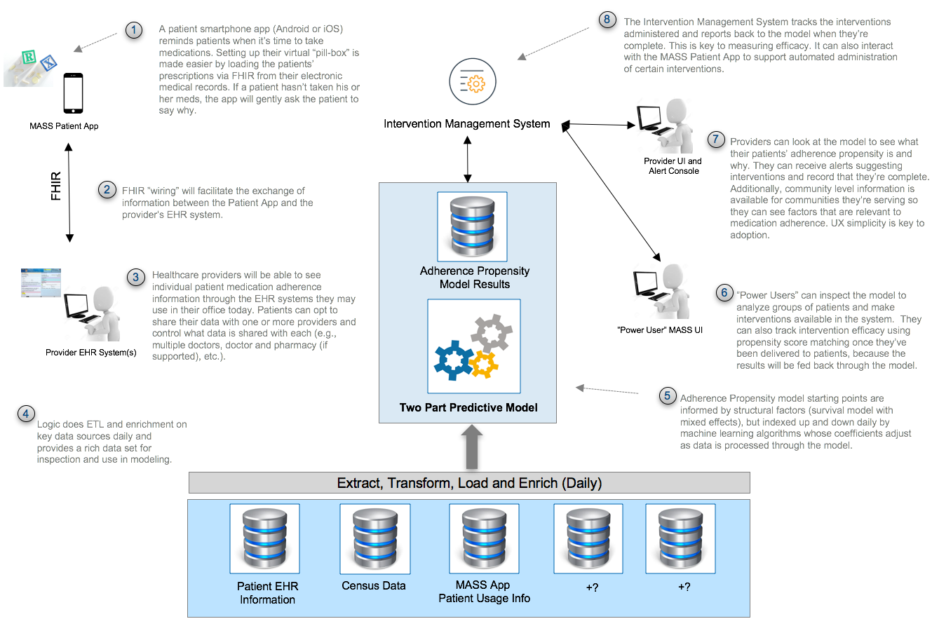
Medication Adherence Support System (MASS): Conceptual Architecture
Notes:
It's is a big, multi-part problem… and there’s lots of value in solving it.
So some folks from the Centers for Disease Control wrote a project proposal to help do that. We took their proposal as our challenge and developed the conceptual architecture you see here.
We’ve shared this with our mentor, Skip Clelland and some of his colleagues at the CDC and incorporated their feedback. Skip has given his thumbs up.
There’s a lot on this page, so if you’d like to spend a little more time with it, just press the pause button.
Let me briefly walk you through it. The solution has five main components:
First, there’s a mobile app for patients. That’s their virtual “pill-box.” It let’s them setup reminders for medications. There are lots of apps available now that do that, but this one gets prescriptions from the patient’s EHR via FHIR and it also captures patient behavior information which is different. (that's number 1 on the diagram)
Second, there’s a “big-data” and analytics component that’s used to model adherence and help create better and more effective ways to help more people take their meds as they should (that's numbers 4, and 5 on the diagram)
Third, there's an “intervention management system” that tracks and in some cases even administers interventions (that's number 8 on the diagram)
Fourth, there’s wiring that gets data to and from the provider's EMR system (that's number 2)
And lastly, there is a Provider UI which augments the provider's existing EMR system. (that's numbers 6 and 7)
It’s a big vision, with a lot of potential. But it's going to be way more work than we have time for this semester. So we’re focusing our work on building a POC of the Patient Facing App.
While we're limiting our work to the patient facing app, we think it’s important to keep the overall solution context shown here in mind as we work.

Slide 4
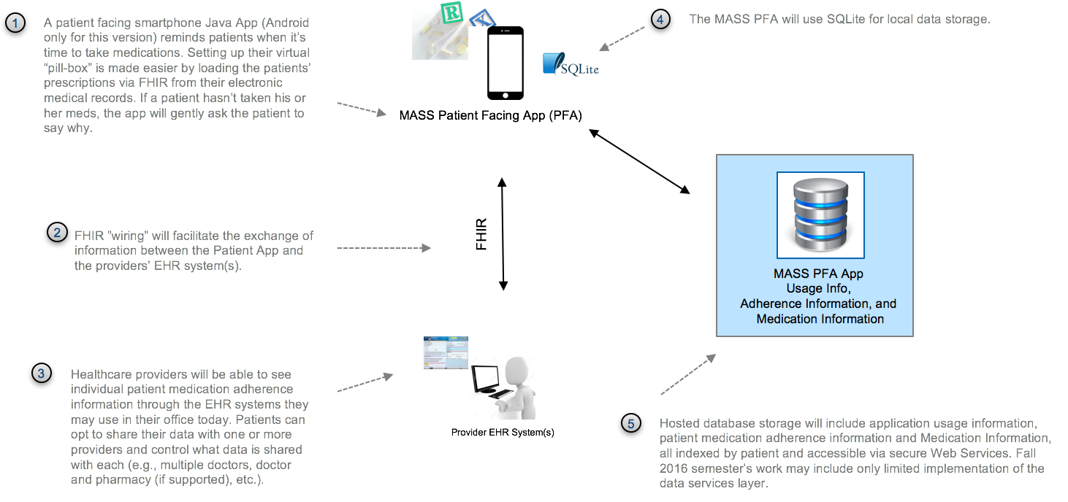
MASS Patient Facing App - Architectural Overview
Notes:
So here’s what the patient app architecture looks like…as I said, this is where we’ll be focusing this semester.
In addition to the notes you saw about this part of the solution on the last slide, you’ll notice that we’ll be connecting to a database to store and access usage information, medication adherence details, and information about the meds people are taking through a web-services layer.

Slide 5
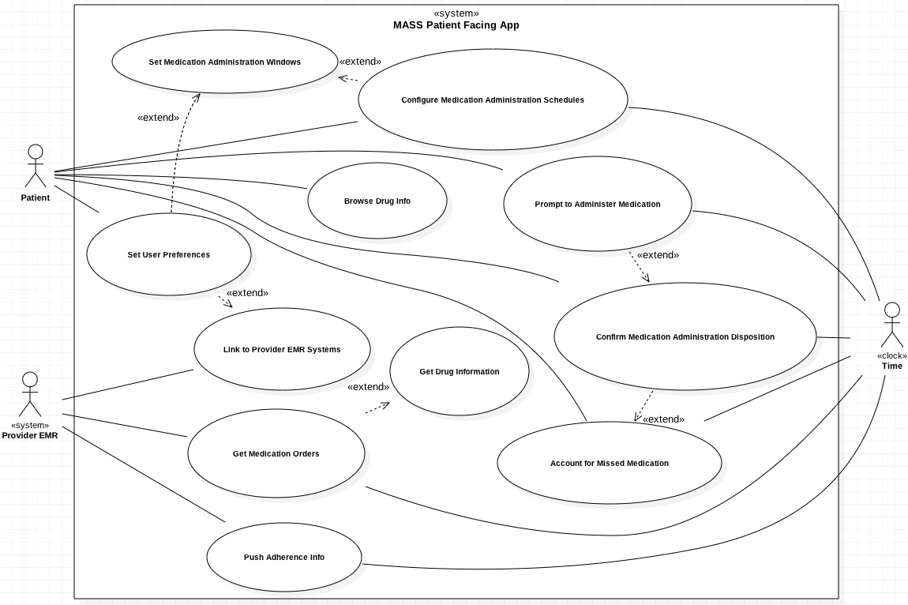
Use Case Diagram
Notes:
Form should follow function, so we started by doing some Use Case Analysis. Here’s what we came up with. A document that details these use cases is available in our GitHub repo. You’ll notice that the three main actors here are the Patient… the Provider EMR system (or systems), and the clock which plays a role in use cases that are triggered at intervals or specific times. Some of the more interesting use cases include “Get Medication Orders” (toward the bottom left) which is about automatically getting medication orders via FHIR, “Push Adherence Info” (just below get medication orders) which is the pushing adherence information back to provider EHRs’, and “Account for Missed Medication” (at the bottom right) which involves asking patients to account for missed medication doses so that information can be used to help make adherence better. Now… let me turn it over to Jiankun to take you through the rest of the briefing, starting with our class diagram.

Slide 6
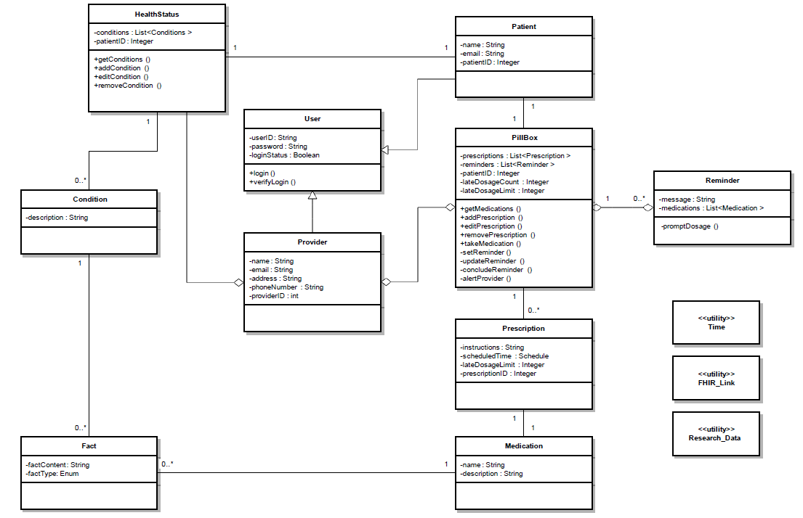
Class Diagram
Notes:
Here’s the class diagram. If you speak UML, you should be familiar with this. Just press the pause button if you’d like to spend more time with this slide.

Slide 7
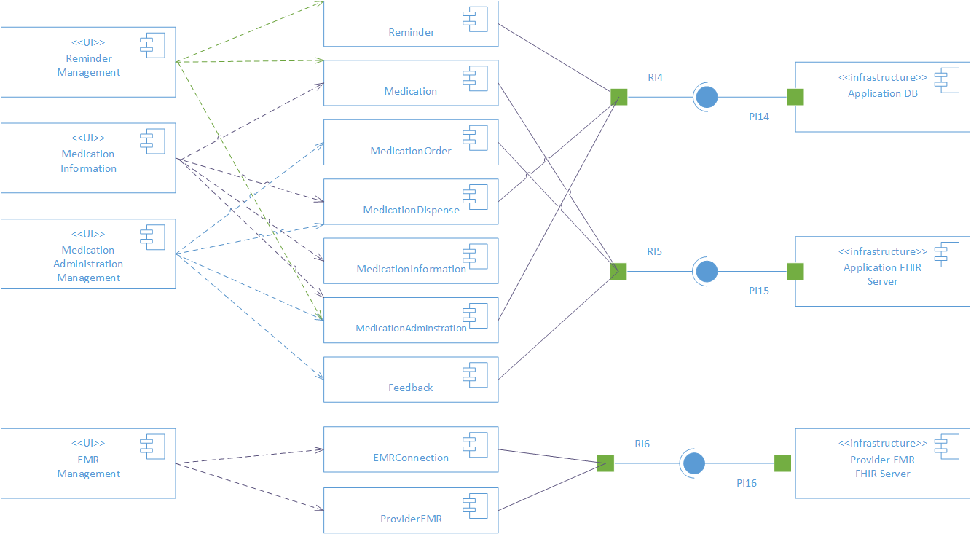
Component Diagram
Notes:
We thought we’d use a UML component diagram to visualize the components that make up the patient facing app solution.
You’ll notice that there are four main UI components … those are shown along the left side of the screen…those UI components, together with the other app components and the external system infrastructure services on the right side of this diagram give you a more detailed technical view of the solution that we’ll be building this semester.

Slide 8
Tools and Languages
Client Development
Android Studio, Java, SQLite
Server Development
Java, MySQL
FHIR Implementation
HAPI
Source and Document Control
GitHub Repo
https://github.gatech.edu/gt-hit-fall2016/Improving-Medication-Adherence
Notes:
We’re adopting a pretty standard set of tools and technologies.
You see them all here.
For the client, we’re using a standard Android Dev Stack. Java and MySQL on the server side. Given Java on the server, we’ll be using a HAPI FHIR implementation.
And no surprise, we’ll be using our GitHub repo for source and document control

Slide 9
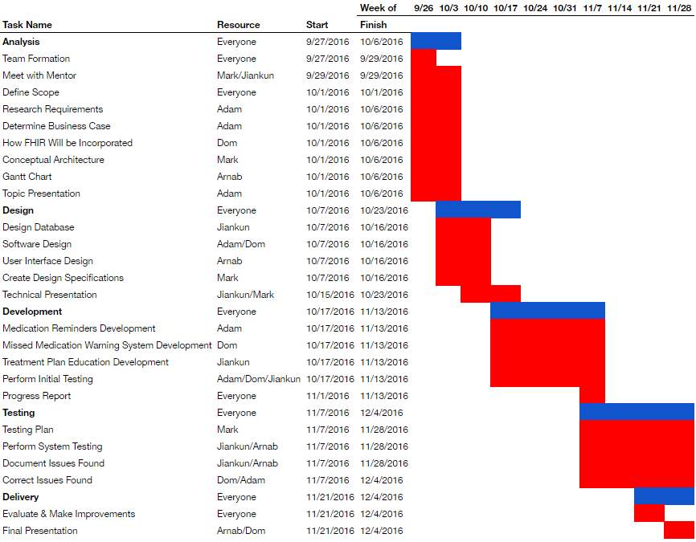
Notes:
Here’s our current Project Plan. We’re following an agile process. We won’t know exactly how far we’ll get with the features until we’re another week or two in and can measure our velocity. And there is no doubt this will change as we progress. But as of today, this is how we plan to organize our team’s work.
That’s the end of our slides.
Check out our GitHub repository for more information. We’ve got more details there about the use cases and a lot of the research and design work that we’ve done so far. There’s a DesignDocument markdown file in a folder called “TechnicalPresentation”. There are also some first draft UI mockups there.
That’s all we have to share for this update. Thanks for your time. We hope you found that at least a little bit interesting.

